Slide 1

AAC in the Home
Parent Guide

Slide 2

First don’t be AAC stressed

Slide 3

This is a guilt free time

Slide 4

Love Languages at home
Body Language

Slide 5

Sign/and or Gestures

Slide 6
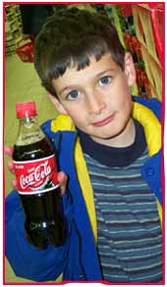
Holding Object or Picture

Slide 7

Device/AAC

Slide 8

Cast Back & Expand
Use any form of communication
Intermittent

Slide 9
Know You Have Support!
Facebook Words for Life User’s Group https://www.facebook.com/groups/1541091616125345/
Help articles and information at www.aacapps.com
Clinician-On-Call text support @ 330-390-4119
Tech Support for LAMP Words for Life app support@aacapps.com
Tech Support # for Accent or PRiO Devices can be found on back of device
PRC local Consultant https://www.prentrom.com/prc_advantage/prc-regional-consultants

Slide 10
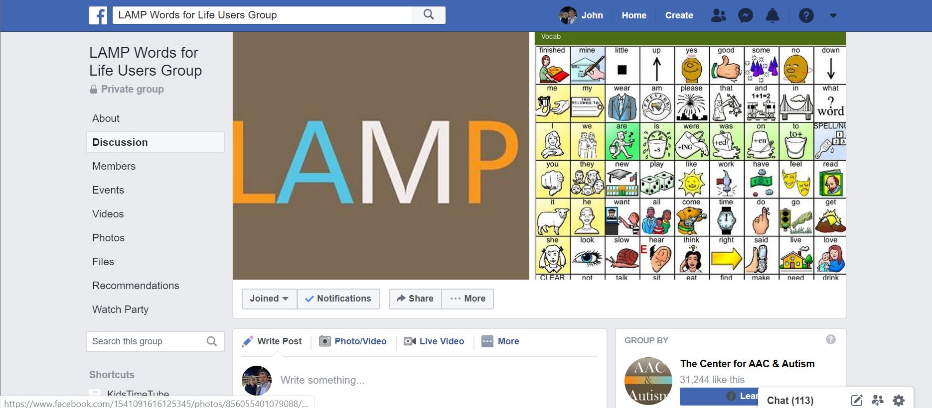
https://www.facebook.com/groups/1541091616125345/
LAMP Words for Life User’s Group on Facebook

Slide 11
Keep it Fun
Examples of fun open ended activities.
run to the room
find the item
act out the word
sing the word
PowerPoint with GIFs https://enter.prentrom.com/owncloud/s/vsmfnUBRza52u0v

Slide 12

Model, Model, Model and then Model Some More

Slide 13
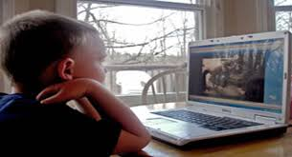
Video Modeling
Show the good stuff
self model
peer model
point of view model
feed forward video model

Slide 14
4 Features to Know
The vocabulary
  word finder
How to lock the device
How to use vocabulary builder
How to add new words

Slide 15

Know the vocabulary

Slide 16
Word Finder
Word Finder on iPad https://youtu.be/DlbjaHuZuFg
Word Finder on Accent https://youtu.be/VKqIDtV7WvE

Slide 17
How to Lock Device
How to lock on iPad
https://youtu.be/wmBOdVRRFzA
How to lock on Accent – NuVoice Software https://www.youtube.com/watch?v=V7tn7prkcOw
How to lock on Accent – Empower Software https://www.youtube.com/watch?v=7KQTSSKyj6o&t=29s

Slide 18
Vocabulary Builder
For iPad https://youtu.be/IUr9-sPHjN4
For Accent – NuVoice software https://youtu.be/KopxQYLoXZo
For Accent – Empower Software https://www.youtube.com/watch?v=gyOM0VzwYHc

Slide 19
Add a New Word
iPad https://youtu.be/2_nOvkmo7b0
Accent – NuVoice Software https://youtu.be/yU3WsFYrRAI
Accent – Empower Software https://www.youtube.com/watch?v=COnF5lCgmJ8

Slide 20
Cheat Sheets
iPad
https://aacapps.com/pdf/LAMP-WFL-for-iPad-Quick-Reference.pdf
Accent – NuVoice Software
http://file.prentrom.com/2093/17949v1_4-Accent-LAMP%20WFL%20QRG-NuVoice.pdf
Accent – Empower Software
http://file.prentrom.com/2204/Accent%20LAMP%20WFL%20QRG-Empower.pdf

Slide 21
How to Find Online Trainings
https://www.prentrom.com/education/classes?type=master_the_technology&method=online&page=1
Future online trainings will be posted on www.aacandautism.com

Slide 22
www.aacandautism.com
Stay Safe
We and all your local team members want to help. They all care!
Live AAC guilt free
Keep it fun
Model and then model some more
Let us know how to support you
Thank you for helping us learn. Sharing is caring

Slide 23

John Halloran M.S. CCC-SLP
Senior Clinical Associate Center for AAC and Autism
Co-Developer LAMP Method
www.aacandautism.com
john.halloran@aacandautism.com
501-951-1588

